Slide 1
Service—news
Input | Output
Tap sequence | Audio
Voice command | Text and picture
Screen input | Video

Slide 2
Input – Basic functions
Functions | Interaction | Scenario 1 In Car | Scenario 2 Home | Scenario 3 Exercising
Wake up | ① Knock twice with the smartwatch | ①② | ①② | ①
 | ② Say “Hi, New”
Play/Pause | ① Say “Play”/”Pause” | ① | ①② | ③
 | ② Press the button on smartwatch screen (specified later)
 | ③ Knock "xx“ on smartwatch
Turn to next news | ① Say “Next” | ① | ①② | ③
 | ② Press the button on smartwatch screen (specified later)
 | ③ Knock “x xx“ on smartwatch

Slide 3
Input – Basic functions
Functions | Interaction | Scenario 1 In Car | Scenario 2 Home | Scenario 3 Exercising
Volume adjustment | ① Say “Up”/“Down”: increase or decrease of the volume is positively proportional with the length of the voice command. | ①②③ | ①③④ | ③④
 | ② Slide up/down with the thumb on the steering wheel, with a sensor or gesture detection camera
 | ③ Drag on smartwatch screen (specified later)
 | ④ Punch up/down with the smartwatch
Choose news genres | ① Choose on the smartphone | ①②③ | ①②③ | ②
 | ② Choose on smartwatch screen
 | ③ Say “Change”

Slide 4
Input – News-related functions
Functions | Interaction | Scenario 1 In Car | Scenario 2 Home | Scenario 3 Exercising
Later viewing | ① Say “Save” | ① | ①② | ②
 | ② Press on the smartphone for 2 seconds
Sharing | ① Share on the smartphone through later-viewing | ①② | ①② | ①
 | ② -User: “Share” -System: “Who do you want to share with?” -User: “XXX“ (with a list of people user often shares news to)
News searching | -User: "Search“ -System: "What do you want to search?“ -User: "KEYWORD" | ● | ●
Related news | Say "Related news" to enter this mode Say "Stop" to exit this mode | ● | ●

Slide 5
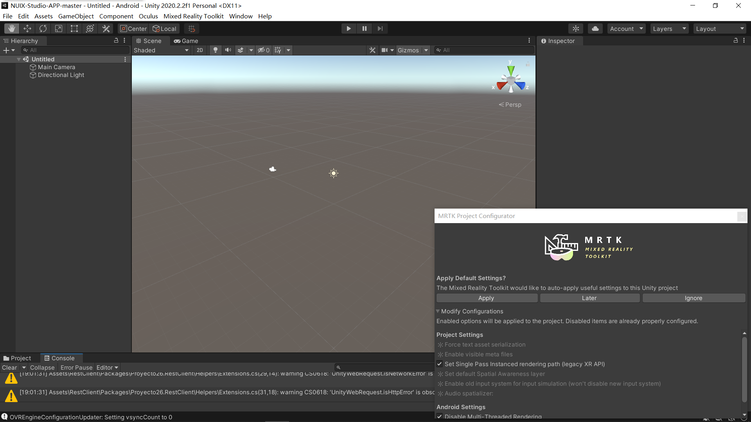
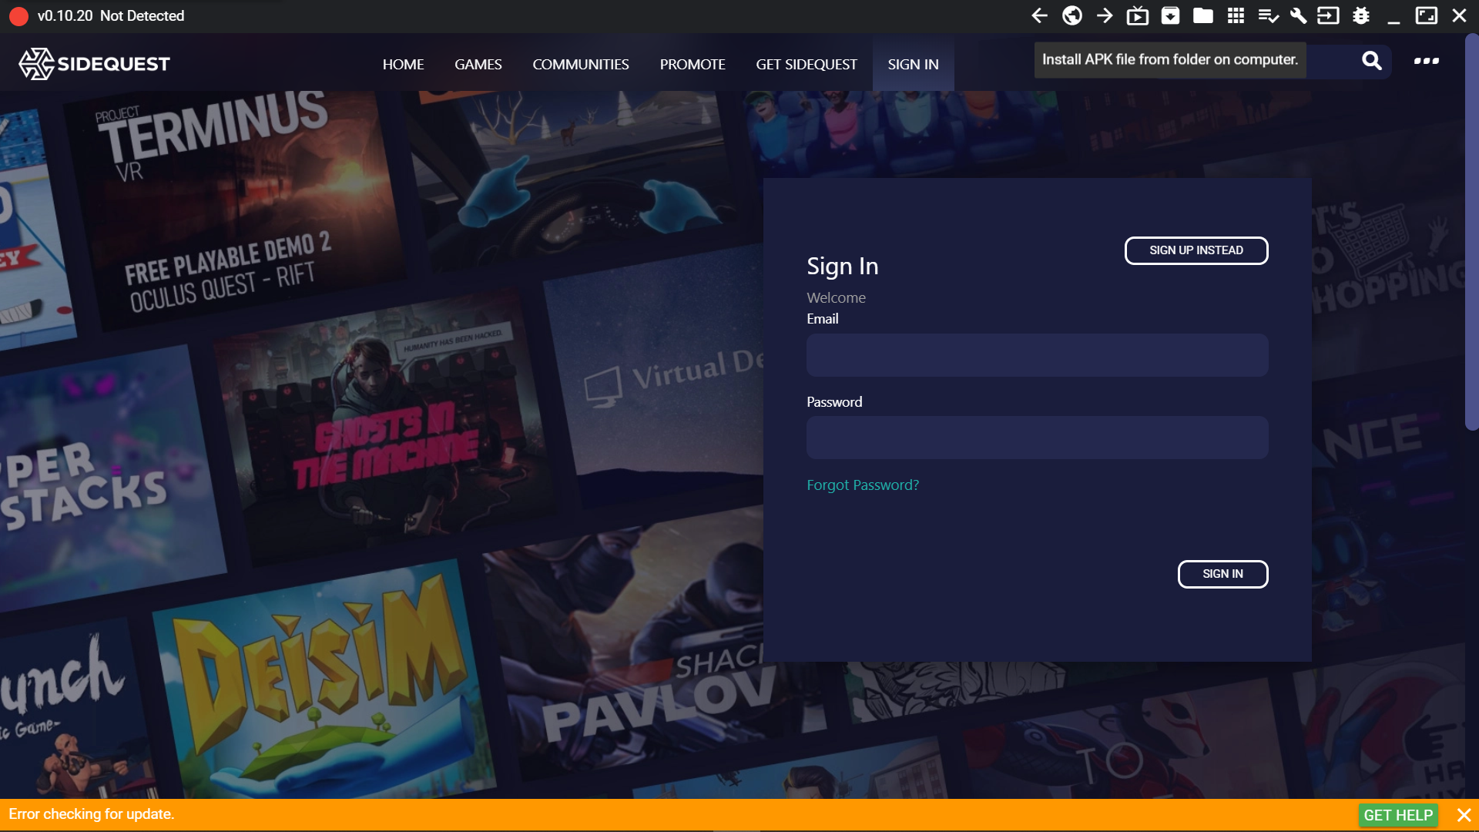
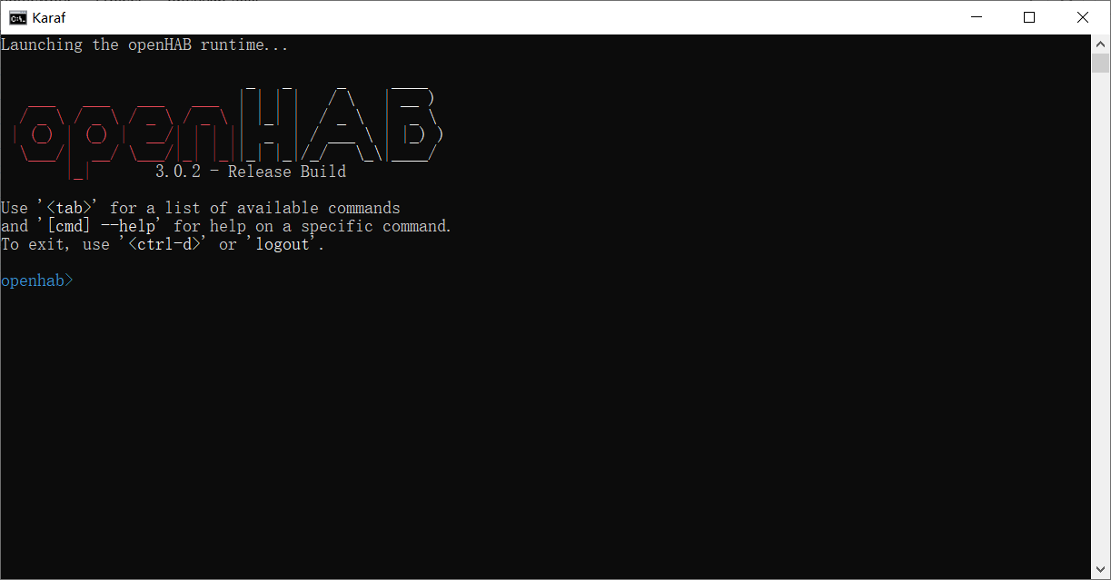
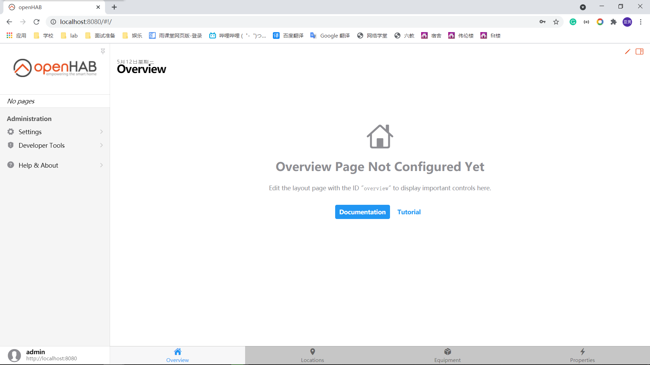
Progress
Unity
Install Unity and Android Build Support
Import NUIX-Studio-APP
Build up the scene
Realize part of the functions
Oculus
Install SideQuest
Install openHAB
Install the apk on Oculus to test

Slide 6

Scenario : Home

Slide 7
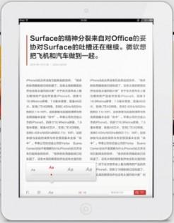
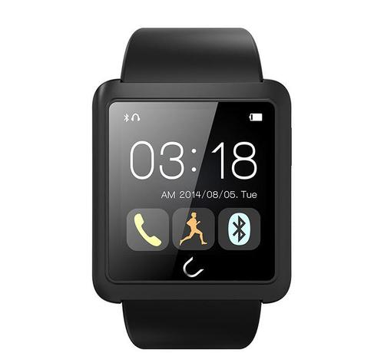
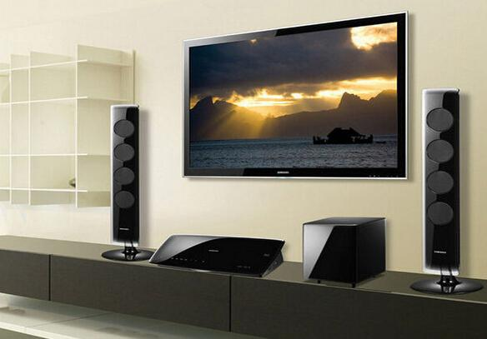
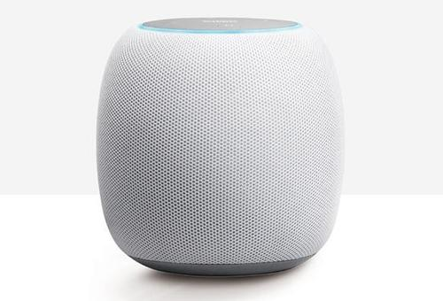
Devices
Smartphone/pad/PC
Smartwatch/bracelet
Smart TV
Bluetooth Speaker/earphones
Hand-pad/Attachable Touchpad
Functions
Basic functions
News-related functions
Transfer of control and content between devices
Separate Input/Output device (Remote control)
Transfer of voice output between stereos according to location
Auto-pause
Auto-correct
Output
News with texts and pictures through smartphone/pad/PC
Video news through smartphone/pad/PC and smart TV
Audio news mainly through Bluetooth Speaker/earphones

Slide 8
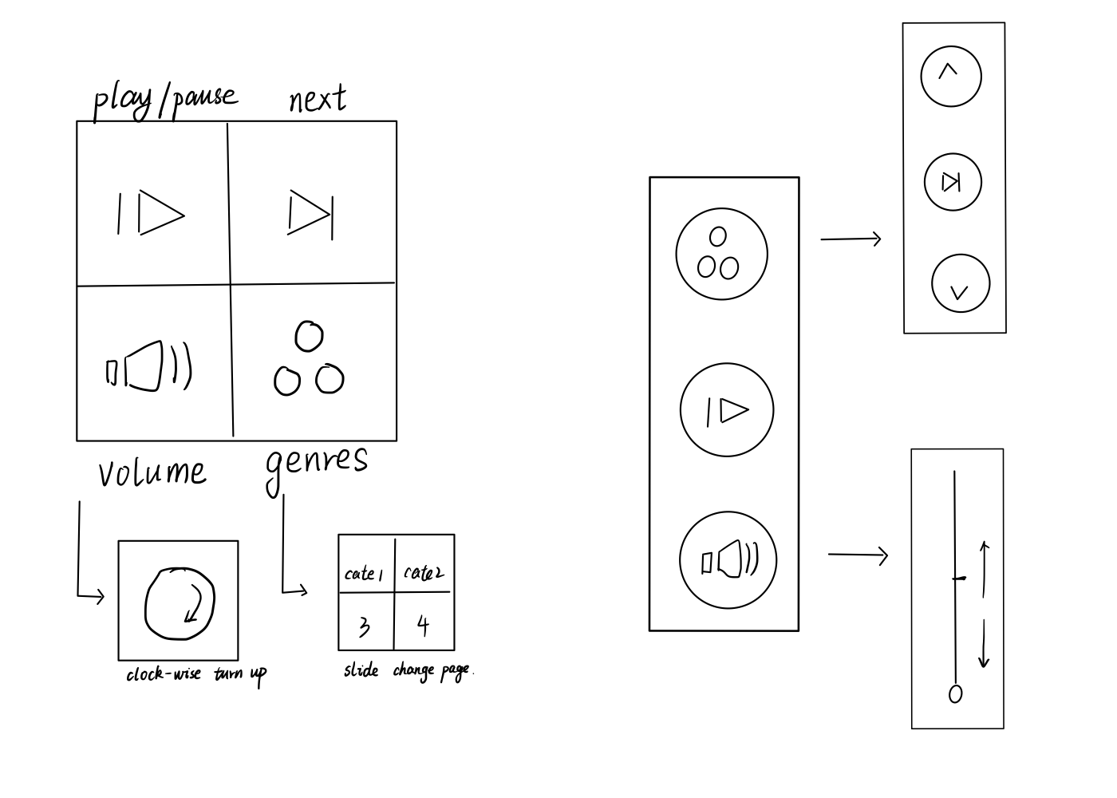
Smartwatch GUI

Slide 9
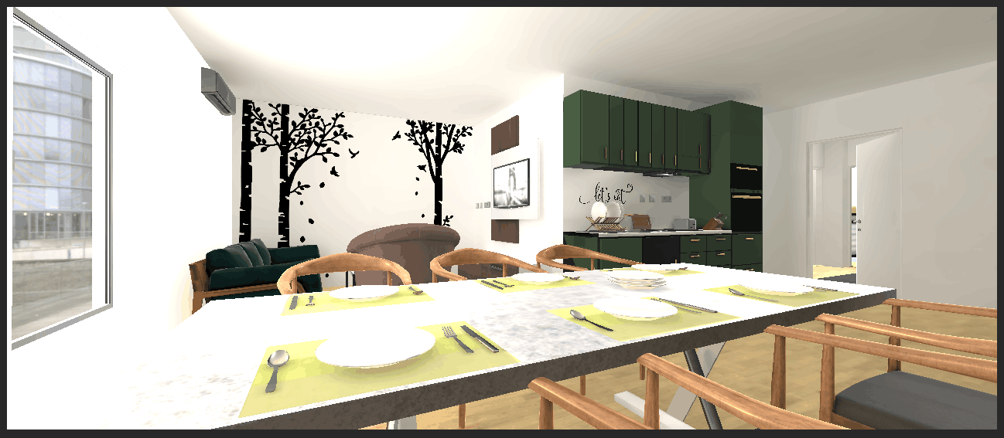
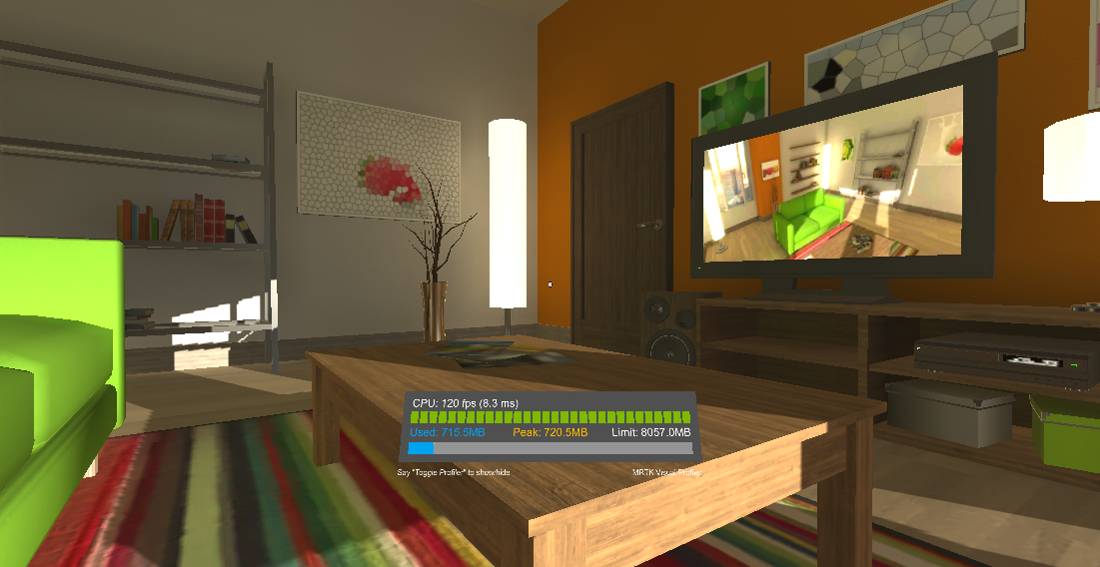
Scene
Take too much time in building

Slide 10
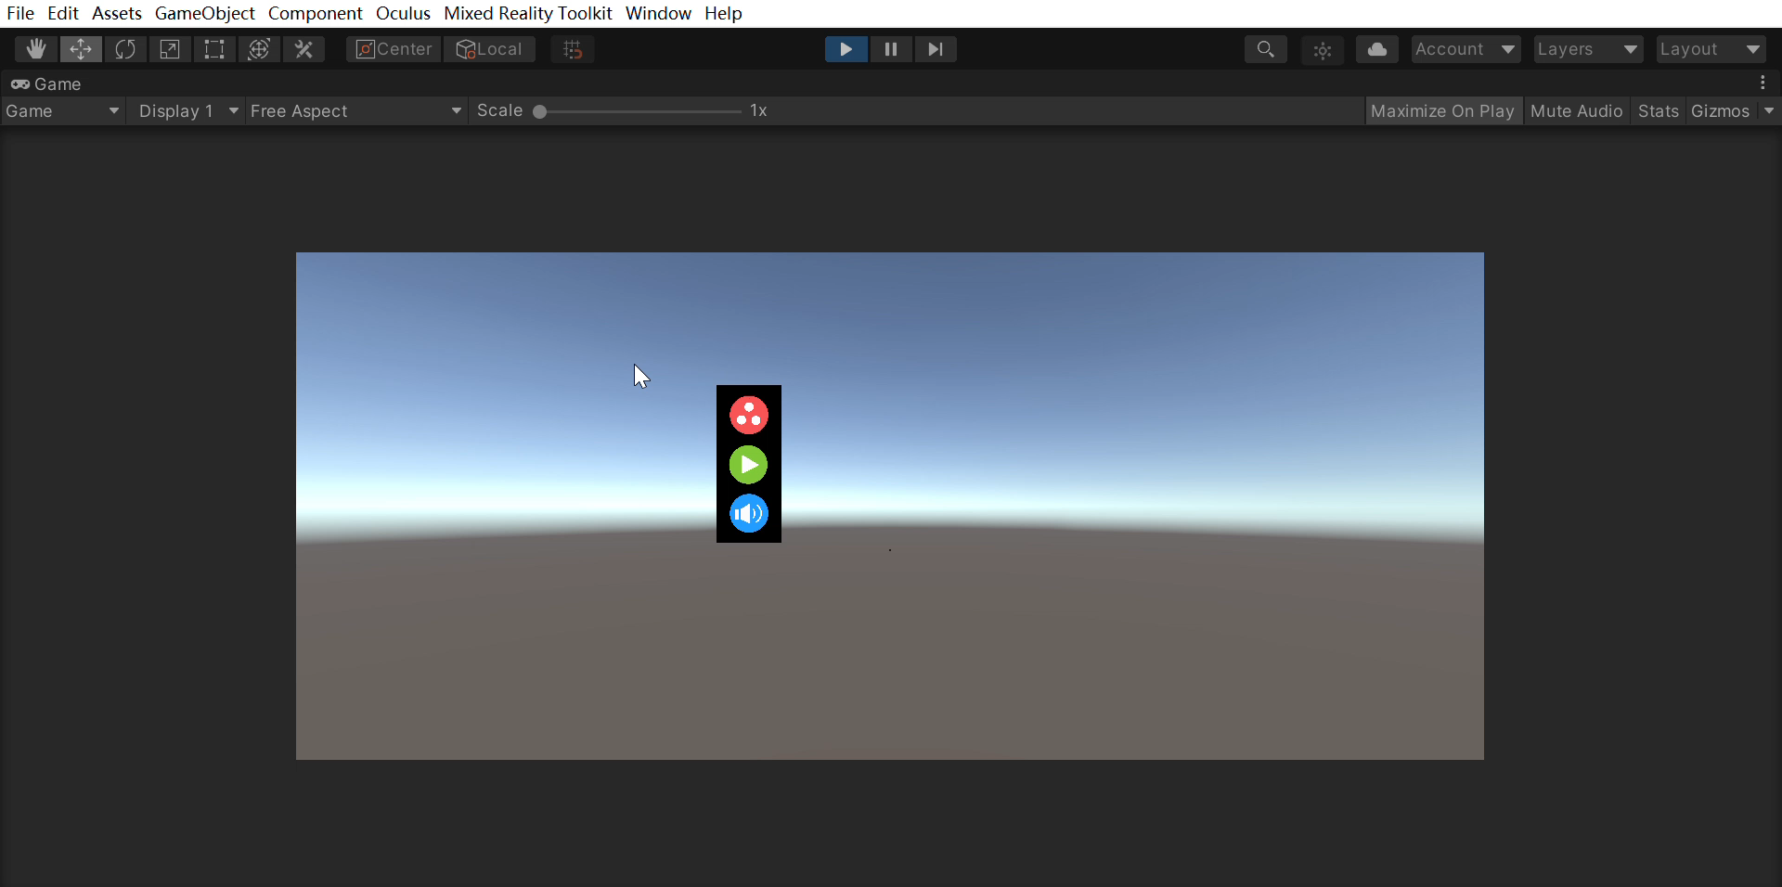
Function

Slide 11
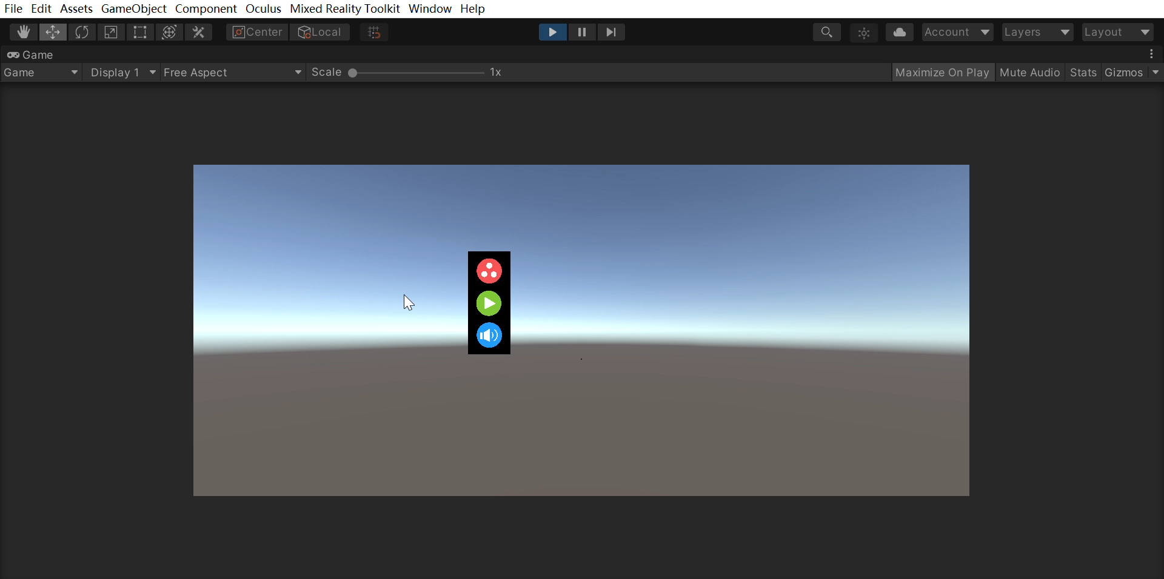
Function

Slide 12
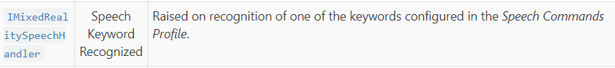
Plan
Voice Control
Location Transfer

Slide 13
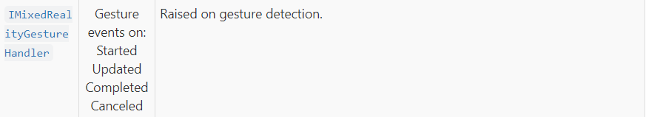
Plan
Gesture Control
Move
Knock

Slide 14
User Study
Car Scenario
For most commands with a single word, the average time is no more than 3 seconds.
For most one-interaction commands with multiple words, the average time is no longer than 5 seconds.
For “Pause”, the average time is much higher than others, because of its high error rate. It can be mistaken as “Pounds”, “Pals” and so on.
 | Play | Pause | Next | Like | Turn Down/Up | Change to Art | Change to Technology | Change to Health | Change to Collection | Search | Exit
Average Time | 2.43s | 4.43s | 2.2s | 1.67s | 2.29s | 4.75s | 4.6s | 4s | 6.67s | 12.33s | 2.33s

Slide 15
User Study
Car Scenario
For “Change” commands, most of them are about 4 seconds.
For “Change to Collection”, the average time is 6.67 seconds, because using “collection” to represent “the news I liked before” is not intuitive and one of the participant forgot the keyword at the first time.
For “Search” commands, the average time is 12.33 seconds, because it needs two steps of interaction, waking up the function and inputting the searching keywords.
 | Play | Pause | Next | Like | Turn Down/Up | Change to Art | Change to Technology | Change to Health | Change to Collection | Search | Exit
Average Time | 2.43s | 4.43s | 2.2s | 1.67s | 2.29s | 4.75s | 4.6s | 4s | 6.67s | 12.33s | 2.33s

Slide 16
User Study
Car Scenario
As for the users’ feedback, most of them thought using voice commands to control the news is a good idea.
They thought the recognition accuracy is satisfying.
However, they also pointed out that some of the keywords used as commands are not pretty rational.
For example, there are many keywords that have a similar pronunciation as “Pause”, which means the users need more time to complete the function.

Slide 17
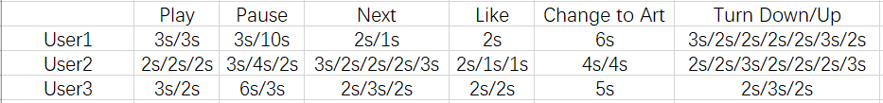
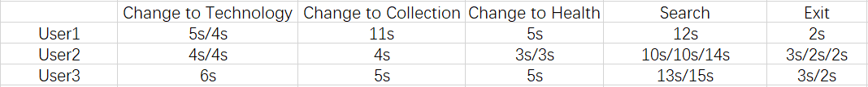
User Study
Car Scenario
Raw data
Improvements
Change some of the keywords
Add auditory feedback for different functions
Optimize the volume adjustment function
For example, “Turn Up to 70%”

